Slide 1
Tick & Ride
an automated Pick & Drop service

Slide 2
Group # 8
Tania Saleem BSCS14016
Sidra Khalil BSCS14024
Hira Akram BSCS14080
Muhammad-ur-Rehman BSCS14081

Slide 3

What is Tick & Ride?
An android based mobile application that can be used for real time pick and drop service…

Slide 4
Introduction
Service provided by “Drag & Drop”.
Real Time tracking of user at Three level
User end
Guardian end
Admin end
Guardian can Access using Pass-Code
User need to register and choose Pick and Drop location
Driver will pick and drop user as per guided by Admin
Admin will approve applications, assign vans to user and will have a view panel

Slide 5
Need
To facilitate people on daily basis
Avoiding public transport problems
Providing more secure pick & drop service
Trustful service

Slide 6
Overview
User
Register
Cancel ride
Drivers
Registration
Authentication of vehicle
Admin Panel
Monitoring
Verifying
choose your pick and drop destination

Slide 7


Slide 8
Functional Requirement
Pick and drop location of users
admin location of all vans
payment methods

Slide 9
Nonfunctional Requirements
Product requirements
Authentication of drivers
user signup
user request approved by admin

Slide 10
Security
location is of user will be accessible to the guardian of user (pin secured end)
admin will authenticate the person via the CNIC card and driving license

Slide 11
Development requirements
android platform for development
“FIREBASE” for server end

Slide 12
Response time
Response time for being a driver is at least one week
Response time for approval of user service is three days
Response time for guardian request for the user location will be quick

Slide 13
Usability
user friendly interface
easy to use

Slide 14
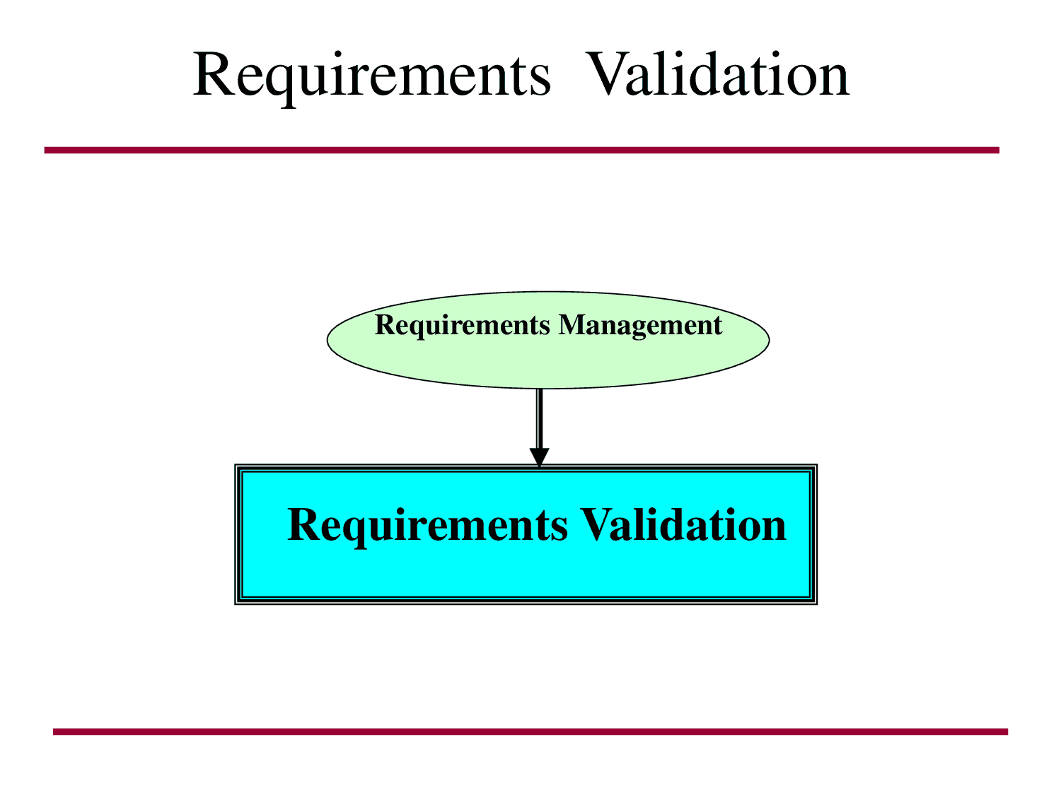

Slide 15
REQUERMENTS VALIDATION
Consistency Checks
No conflicts
☺
Realism Checks
Easily implemented by current technology
☺
Verifiability Checks
prototyping
☺

Slide 16


